Slide 1
Object Oriented Programming Lecture - 29
Prof. Varsha Dange

Slide 2
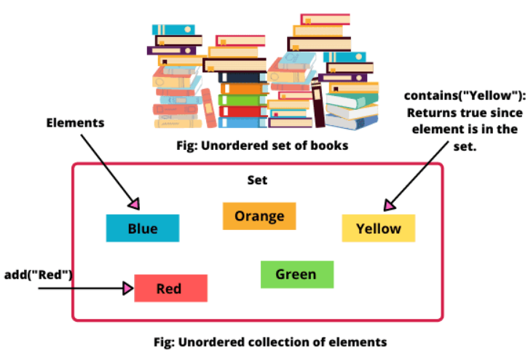
Set in java
set in Java is an unordered collection of unique elements or objects.

Slide 3
Set in java
set in Java is an unordered collection of unique elements or objects.
Set is a child interface of Collection.
Insertion order not preserved i.e., They appear in the different order in which we inserted.
Duplicate elements are not allowed.
Heterogeneous objects are allowed.
Set Interface is implemented by using LinkedHashSet and HashSet class.

Slide 4
Set in java
It can be iterated by using Iterator but cannot be iterated by using ListIterator.
Most of the set implementations allow adding only one null element.
Tree set does not allow to add null element.
Set is not an indexed-based structure like a list in Java. Therefore, we cannot access elements by their index position.
It does not provide any get method like a list.

Slide 5
Set in java
It can be iterated by using Iterator but cannot be iterated by using ListIterator.
5. Most of the set implementations allow adding only one null element.
Tree set does not allow to add null element.
Set is not an indexed-based structure like a list in Java. Therefore, we cannot access elements by their index position.
It does not provide any get method like a list.

Slide 6
Set in java
It can be iterated by using Iterator but cannot be iterated by using ListIterator.
5. Most of the set implementations allow adding only one null element.
Tree set does not allow to add null element.
6. Set is not an indexed-based structure like a list in Java. Therefore, we cannot access elements by their index position.
8. It does not provide any get method like a list.

Slide 7
Set in java
Method | Description
boolean add(Object o) | It is used to add the specified element in this set.
boolean addAll(Collection c) | This method adds all the elements in the given collection.
int size() | It is used to get the number of elements in the set.
boolean isEmpty() | This method checks that the set is empty or not.
void clear() | It is used to remove all the elements from the set.
boolean contains(Object o) | This method returns true if this set contains the given element.
boolean containsAll(Collection c) | This method returns true if this set contains all the elements of the given collection.
boolean remove(Object o) | It is used to remove the specified element from this set.
boolean removeAll(Collection c) | It removes all the elements in the given collection from the set.
Iterator iterate() | It returns an Iterator over the elements in this set.
boolean equals(Object o) | It is used to compare the given element for equality in this set.
int hashCode() | It is used to get the hash Code value for this set.

Slide 8
Set in java
Example1
Example2
Example3

Slide 9
How to Iterate Set in Java
Using Iterator Example1
Using Enhanced for loop Example2
Using forEach()

Slide 10
Java HashSet
HashSet in Java is an unordered collection of elements (objects) that contains only unique elements.
This hashSet allows null values.
It does not maintain insertion order. It inserted elements based on their hashcode.
it is present in java.util.HashSet package.

Slide 11
Java HashSet constructor
1. HashSet(): It constructs an empty HashSet (i.e, default HashSet). The default capacity is 16
2. HashSet(int initialCapacity): It initializes the capacity of HashSet. When the set capacity reaches full and a new element is added, the capacity of the hash set is expended automatically.
3. HashSet(int initialCapacity, float fillRatio): This form of constructor initializes capacity and fill ratio (also called load factor or load capacity) of the hash set.
When the number of elements is greater than capacity of HashSet, the size of the HashSet is grown automatically by multiplying capacity with load factor.
The default value of the load factor is 0.75.
4. HashSet(Collection c): It initializes HashSet by using elements of c. This constructor acts as a copy constructor.
It copies elements from one collection into the newly created collection.

Slide 12
Java HashSet constructor
Example1
Example2

Slide 13
LinkedHashSet in Java
LinkedHashSet in Java is a concrete class that implements set interface and extends HashSet class with a doubly linked list implementation.
internally uses a linked list to store the elements in the set.
The LinkedHashSet class extends the HashSet class.
The basic data structure is a combination of LinkedList and Hashtable.
Insertion order is preserved.
Duplicates are not allowed.
LinkedHashSet is non synchronized.
Example1
Example2
Example3

Slide 14
Map in Java
map in Java is a container object that stores elements in the form of key and value pairs.
A key is a unique element (object) that serves as an “index” in the map.
A map is a part of the collection framework but it does not implement a collection interface.
A map stores values based on Key and value Pair.
Duplicate keys are not allowed.
Key must be unique while duplicates values are allowed.

Slide 15
Methods of Map in Java
1. V put(K key, V value): It is used to add an entry with specified key and value in the map.
2. void putAll(Map m): It is used to add all entries from into this map.
3. V putIfAbsent(K key, V value): It is used to add specified value with specified key in the map only if it is not already specified.
4. V remove(Object key): This method is used to delete an entry for the specified key. It will return null if the key is not in the map.
5. boolean remove(Object key, Object value): This method is used to remove the specified value associated with specified key from the map.

Slide 16
Methods of Map in Java
6. Set<K> keySet(): This method returns a set consisting of the keys in the invoking map. It provides a set-view of the keys.
7. void clear(): This method is used to remove all entries from the map.
8. V get(Object key): This method returns the value for the specified key in this map.
9. int hashCode(): It returns the hash code value for the invoking map.
10. boolean isEmpty(): This method is used to check whether the map contains any entries. It returns true if the invoking map is empty, otherwise returns false if it contains at least one key.

Slide 17
Methods of Map in Java
11. int size(): The size() method returns the number of entries (number of key/value pairs) in the map.
12. V replace(K key, V value): This method is used to replace the specified value for a specified key.
13. boolean replace(K key, V oldValue, V newValue): This method is used to replace old value with new value for a specified key.
Example1
Example2
Example3
Example4

Slide 18
Vector in Java
The Vector class implements a growable array of objects.
It is found in the java.util package and implements the List interface, so we can use all the methods of List interface
Every method is synchronized.
The vector object is Thread safe.
At a time only one thread can operate on the Vector object.
performance is low because Threads are needed to wait.

Slide 19


Vector in Java
Constructors:
1. Vector(): Creates a default vector of the initial capacity is 10.
2. Vector(int size): Creates a vector whose initial capacity is specified by size.
3. Vector(int size, int incr): Creates a vector whose initial capacity is specified by size and increment is specified by incr.
4. Vector(Collection c): Creates a vector that contains the elements of collection c.

Slide 20
Vector in Java
Example1
Example2(Changing Elements)
Example3(iterate the elements in a Vector)

